Slide 1

Megathon’22
Team: Ozzy Mann
Abhinaba Bala

Slide 2
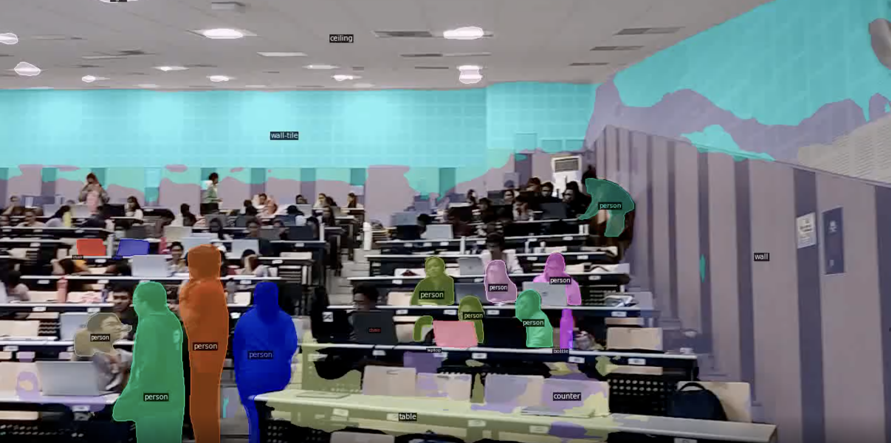
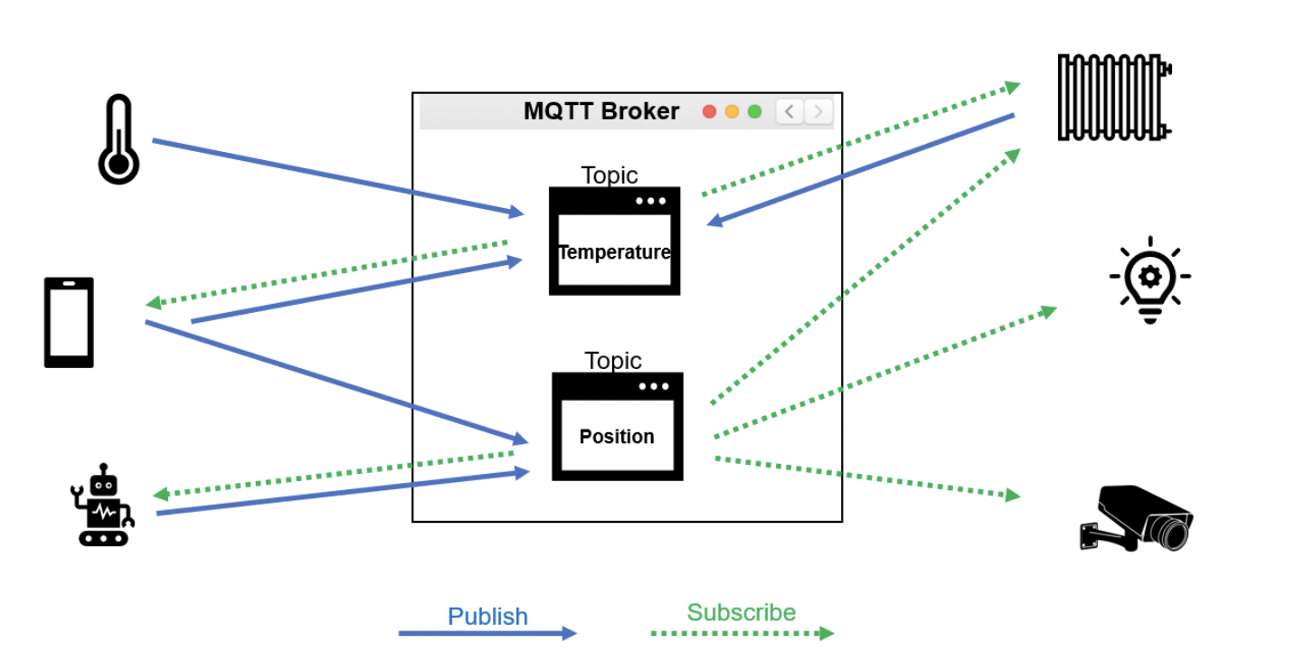
Question-2
Image Detection/Segmentation using AI algorithms
Implementing MQTT (or other) protocol or secure cloud communication protocol

Slide 3
Image Detection/Segmentation using AI algorithms

Slide 4
Objective
Motivation
Object segmentation (Panoptic Segmentation)
Real-time object detection
We want our solutions to have both accuracy and responsiveness.
In addition to detection we might require extra semantic information.

Slide 5
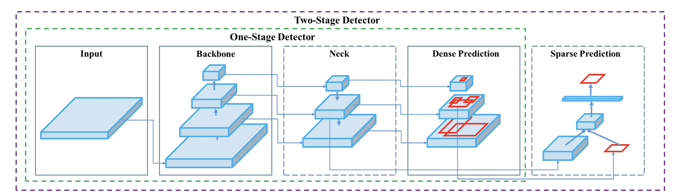
Architecture (YOLOv4)

Slide 6
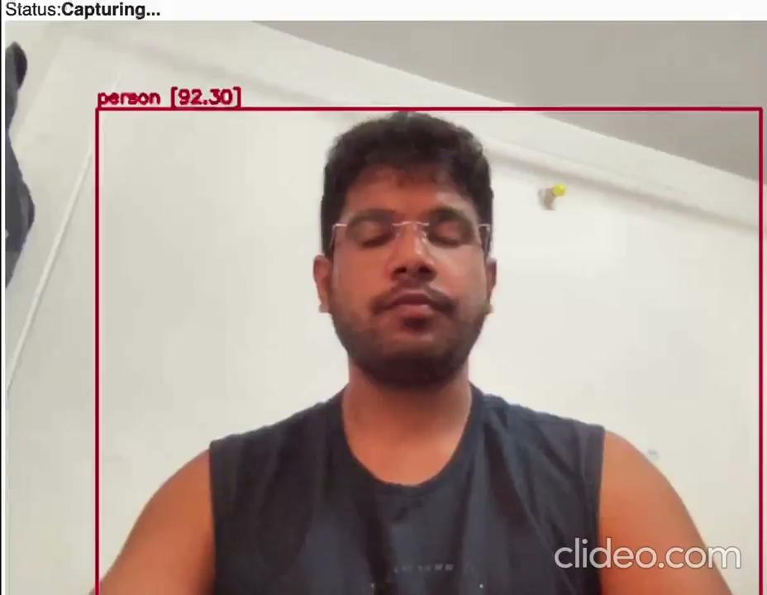
Results (YOLOv4)

Slide 7
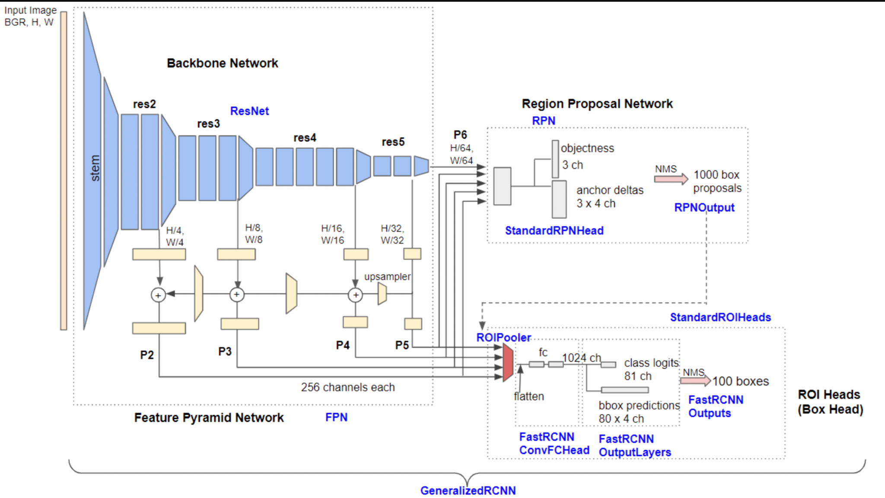
Detectron2

Slide 8
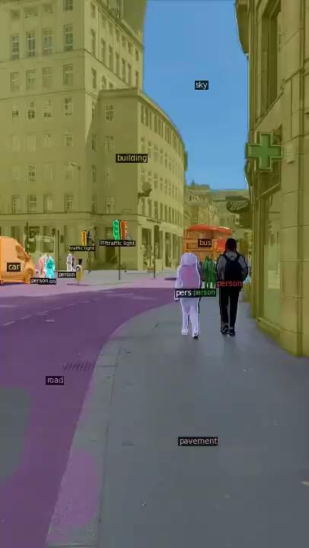
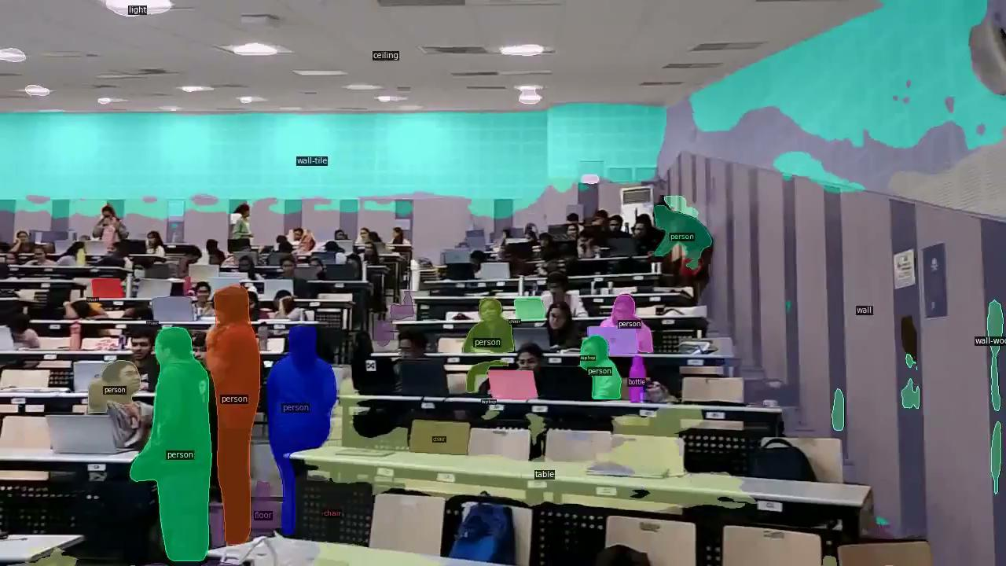
Results (Detectron2)

Slide 9

Results (cont.)

Slide 10
Implementing MQTT (or other) protocol or secure cloud communication protocol

Slide 11
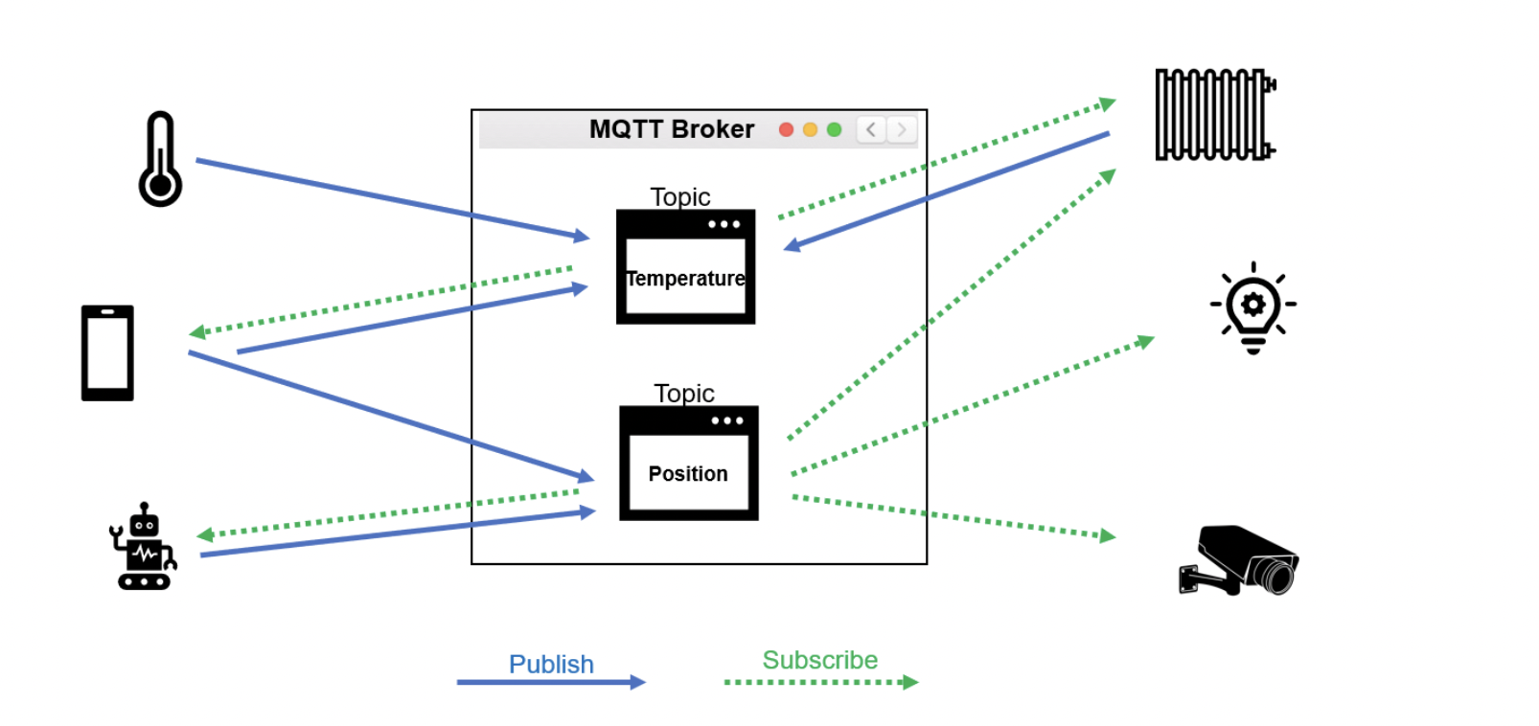
MQTT

Slide 12
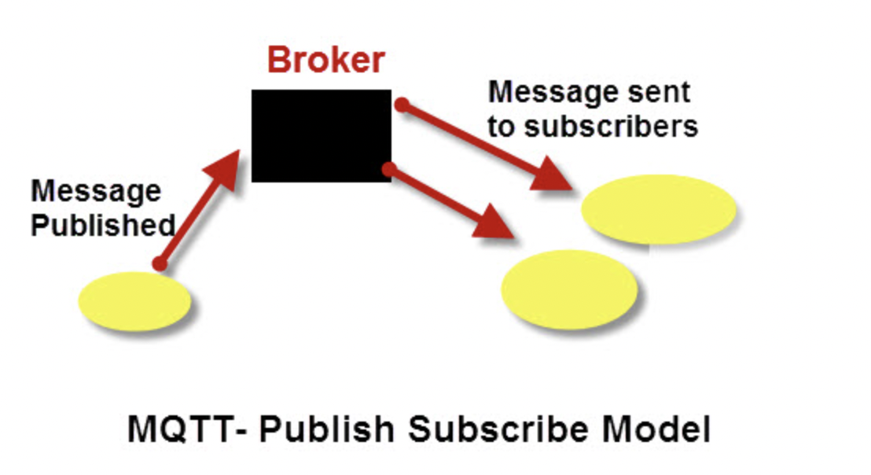
Motivation behind MQTT
Although HTTP and MQTT both run over TCP, MQTT was designed for IoT.
Once an MQTT connection is established, any number of messages can be sent through it in both directions, data from sensor to back-end, and commands the other way.
It aims to minimize data overhead of each MQTT packet.
Publish subscribe routing, which allows the easy addition of more consumers and producers of data.

Slide 13
References
Real-time YOLOv4 Object Detection on Webcam
Detectron2
MQTT vs HTTP for IoT

